Slide 1
Module 2: Data
Representing and Analyzing Data
ML for Cybersecurity
Fall 2020

Slide 2
Learning Objective

Slide 3
Learning Objectives
Describe the considerations and challenges around choosing how to represent network data for analysis and modeling
Load network traffic that has been collected into software libraries
Represent your network data in ways that can be inputted into machine learning models

Slide 4
Data Representation

Slide 5
Modeling: Data Representation
We aim for general representations, with consideration of cost/complexity as part of the optimization.
Many challenges for representing the data
Scale (constantly generated)
Sequential dependencies (handshakes, parameter negotiation)
Non-uniform timeseries (network traffic is “bursty”)
Cross-flow dependencies (applications don’t use one flow)
Many choices for representing traffic data, with different costs.
Packet: Each packet is raw input to the model.
Event: Each “traffic event” is a data point (e.g., spike in traffic). (Could also sub-select on only anomalous events, such as deviation from moving average.)
Time: Traffic statistics are grouped/binned in time (challenge: bin size)
Volume: Bins based on volume (non-uniform intervals). (Standardizes events.)

Slide 6
Modeling: Model Selection
Consider problems with different levels of complexity.
Simple Detectors: Non-Temporal Models
Random forest, SVM
Convolutional Neural Network
Work on some representations (volume based)
Challenge: Do not capture temporal features
More Complex Detectors: Temporal Models
Long Short-Term Memory (LSTM), Gated Recurrent Units (GRU)
Can be used to capture temporal information from the features

Slide 7



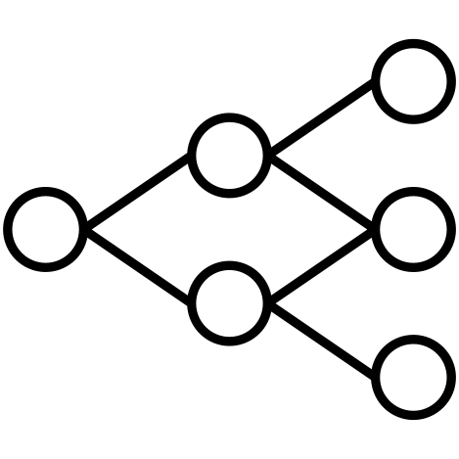
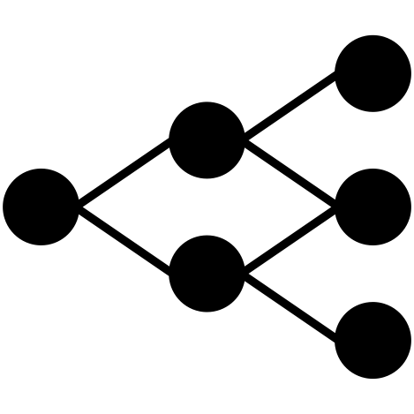
General Traffic Analysis Framework
Labels
Representation
Compression
(Optional)
Input
(Packets)
Packet
Transformation
Data
Representation
Model
Training
Output
(Trained Model)
Each step has an associated cost.
Goals:
Explore general capabilities, capturing the limits of what is possible in traffic analysis
Consider cost-accuracy tradeoffs
Notes:
Our pipeline works, but what if we want to make the representation even smaller?
Faster training
Faster transformation

Slide 8
Different Ways to Represent Traffic
”Raw” network traffic
High volume
Models may learn the wrong things
Aggregated flows
May obscure important features (e.g., timing)
Summary statistics
Sensitive to parameter tuning
Time bins and other parameters may affect model accuracy

Slide 9
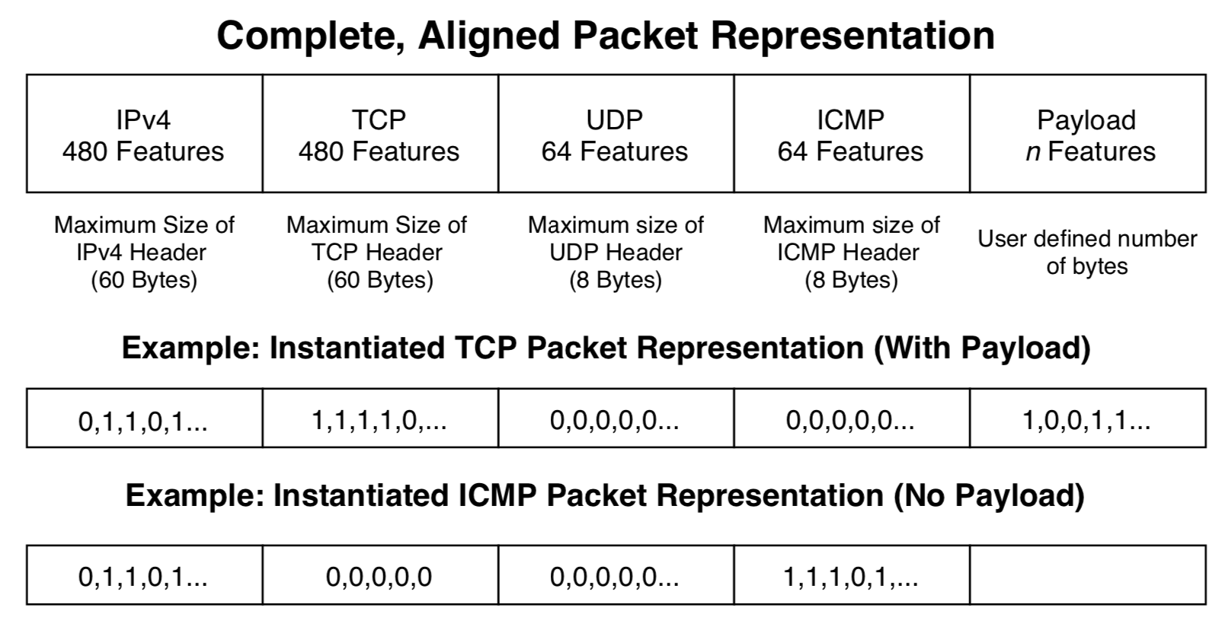
One Approach: Aligned Packet Header

Slide 10
DEMONSTRATION: Representation and ML PipeLINES

Slide 11
